Slide 1
Final Project Submitted By: Sonymon Chirakkadavil Joseph

Slide 2
DESCRIPTION OF THE RESEARCH :
In this research, I am evaluating the “Birthweight” dataset, which contains 1,174 observations and 7 features. Out of these 7 variables, 6 are independent and 1 is dependent—bwt (birth weight in grams).
After analyzing the dataset, I will assist Mr. John Hughes in understanding the following:
How the mother's smoking habit affects the newborn baby's birth weight, using a Linear Regression Model. For this analysis, the variable “smoke” will be used as the predictor.
Analyze the effect of all independent variables—gestation, region, age, height, weight, and smoke—on the birth weight of the newborn baby, using a Multivariate Regression Model.

Slide 3
COMPUTATION OF BASIC STATISTICS OF VARIABLES:
The R codes used for finding the Basic Statistics were provided in the Word document
1.bwt:
a)Mean: Mean is the average of all data points
Mean of the “bwt” by using the R code is 3386.788
b)Median:Median is the middle value of the given data set.
Median of the “bwt” by using the R code is 3402
c)Standard Deviation: The standard deviation provides a mathematical indicator to determine the degree of numerical distribution within a data collection.
Here Standard deviation is 519.6163
d)Min/Max: Min/Max are the Minimum and Maximum values in the data set.
Minimum value in the data set is 1559.3
Maximum value in the data set is 4989.6

Slide 4
COMPUTATION OF BASIC STATISTICS OF VARIABLES:
2.gestation:
Mean:279.1014
Median:280
Standard Deviation:16.01031
Min/Max:
Minimum Value=148
Maximum Value=353
3.age:
Mean:27.32879
Median:26
Standard Deviation:5.928466
Min/Max:
Minimum Value=14
Maximum Value=46

Slide 5
COMPUTATION OF BASIC STATISTICS OF VARIABLES:
4.height:
Mean:162.7087
Median:163
Standard Deviation:6.511867
Min/Max:
Minimum Value=135
Maximum Value=183
5.weight:
Mean:58.276666
Median:56.7
Standard Deviation:9.403371
Min/Max:
Minimum Value=39.5
Maximum Value=113.4

Slide 6
COMPUTATION OF BASIC STATISTICS OF VARIABLES:
6.region:
No of northeast regions=284
No of northwest regions=281
No of southeast regions=325
No of southwest regions=284
7.weight:
No of Non smokers=715
No of Smokers=459

Slide 7
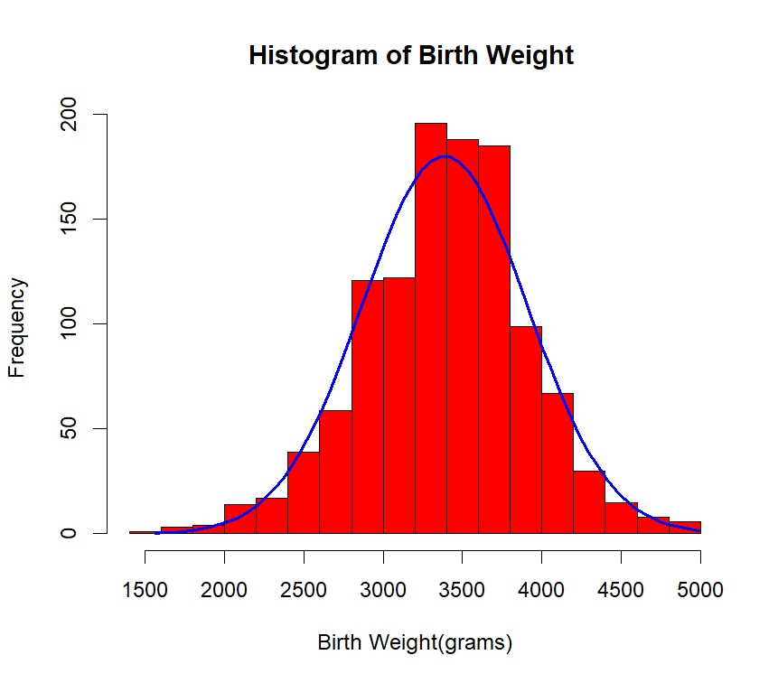
HISTOGRAM OF THE DEPENDENT VARIABLE(bwt):
The attached histogram data distribution follows a bell shape, so it shows an approximate normal distribution and most of the birth weights were clustered in between the ranges 3300-3500 grams.

Slide 8
Analysis of 2 sided T-test:
Following are the steps to be followed in this analysis
1)Define the Hypothesis:
Null Hypothesis (H₀):H₀: µ = 3400
Alternative Hypothesis (​Ha):Ha: µ ≠ 3400
2)Determine the Significance level(α):The value of significant level will help me to take the decision. Here I will choose α=0.05
3)In this step I have to perform 2 sided 1 sample T-test in R and find the t value and P value.
4)Find the P-value from the test statistics and compare it with significance level.
5)Make a decision using the P values and test statistics.

Slide 9
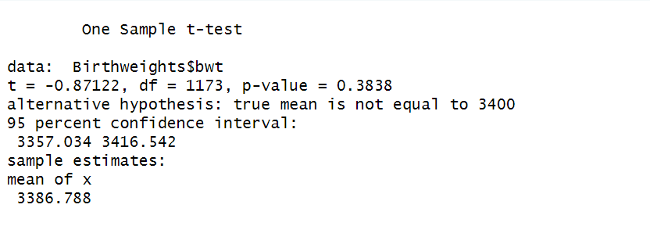
.
EXPLANATION OF THE t-Test
1.t-value(-0.87122):The obtained t-value shows the distance of sample mean (3386.788) from the hypothesized mean (3400).
2.Sample Mean(3386.788):It is the average of birth weight Sample
3.Degree of freedom(1173):
It is normally n-1,where n is the total no of observations in the sample.
4.P-Value(0.3838):
Here P-value is greater than Significance level(α=0.05),we fail to reject null hypothesis.
5.Conclusion: At significance, level of 0.05 we can say that sample mean of birth weight has no significant difference from the given mean of 3400.

Slide 10
.
SIMPLE LINEAR REGRESSION
Simple Linear Regression: The Simple Linear Regression model constitutes a fundamental statistical prediction method which uses two variables for estimating target outcomes. The method is known as "simple" because it operates with two evaluating features.
The Simple Linear Equation can be written as
Y = β0 + β1X+ ϵ
Where,
Y = Dependent variable, here “bwt” is our dependent variable.
X = Independent variable, here “smoke” is our independent variable.
β0 = intercept
β1= the slope
ϵ =error term,

Slide 11
.
Simple Linear Regression(Analysis):
I will be using the following steps for Conducting the Simple Linear Regression Model.
1)Define the Hypothesis:
Null Hypothesis (H₀): There is no significance relationship between mother’s “smoke” and birth weight of baby(β₁ = 0).
Alternative Hypothesis (​Ha): There is a significant linear relationship between mother’s smoke and birth weight of the baby(β₁ ≠ 0).
2)Determine the Significance level(α):Here I have to chose the significance level(α=0.05), 95% significance level.
3)Conduct the F statistics and find the statistics values
4)obtain the P-value from the above test and compare it with significance level (α)
5)Arrive a conclusion using the test Statistics and P value.

Slide 12
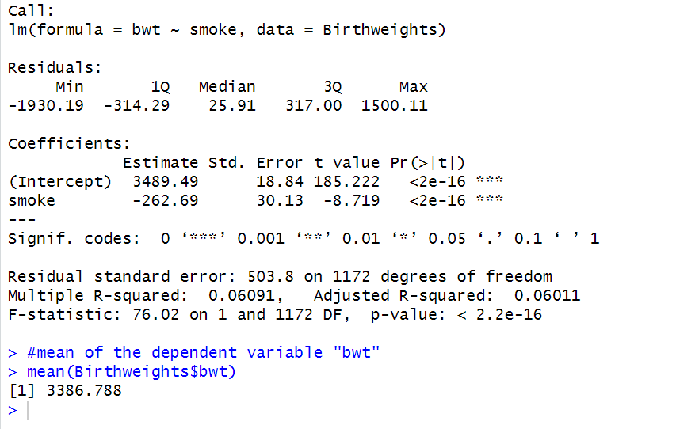
.
Simple Linear Regression(Output Analysis):
Based on the R output,the simple linear equation can be written as,
bwt=3489.49+(-262.69).smoke
ie, bwt=3489.49-262.69.smoke
1.Intercept:The intercept value represents the average birth weight of the new born baby whose mother is a non smoker.From the result it is 3489.49
2.Slope:Here the slope value is -262.69 which means that when the smoker mother is increases by 1 unit then the weight of the new born baby weight decreases by 262.69 grams.

Slide 13
.
3.Standard Error: For the independent variable “smoke” it is 30.13 which is small and indicate that the accurate estimate.
4.t-value:The t value express how many standard errors are away from the estimate. Here the value is -8.719
5.Call:It tells about the dependent variable(bwt) and independent variable(smoke) and shows these 2 variables in the “Birthweights” data.
6.Residuals:Residuals provide the values of difference between the actual birth weight and predicted birth weight value.
Min: The negative value of -1930.19 indicate that the model is over predicted by the birth weight of 1930.19
Max:The positive value of 1500.11 pointed out that the model is underpredicted by the value of 1500.11

Slide 14
.
1st Quartile(1Q):The value -314.29 indicate that 25% of residual coming under -314.29 grams of newborn baby’s weight.
3rd Quartile(3Q):The value 317 indicate that 75% of residual coming under 317 grams of newborn baby’s weight.
Median: It indicate the half of the residuals are coming under 25.91g
7.R-Squared:It gives the 6.1% variation of birth weight of the newborn baby by comparing with smoking habit of mother. Here the R-Squared value is 0.0691(6.1%).The low R-squared means still more details need to be consider for the better analysis.
8.Adjusted R-Squared: Since here we have only one prediction(birth weight of newborn) the value of Adjusted R-Squared value is almost same as the R-Squared. Here the value is 0.06011 and only 6% of variation is considered for the newborn birth weight.

Slide 15
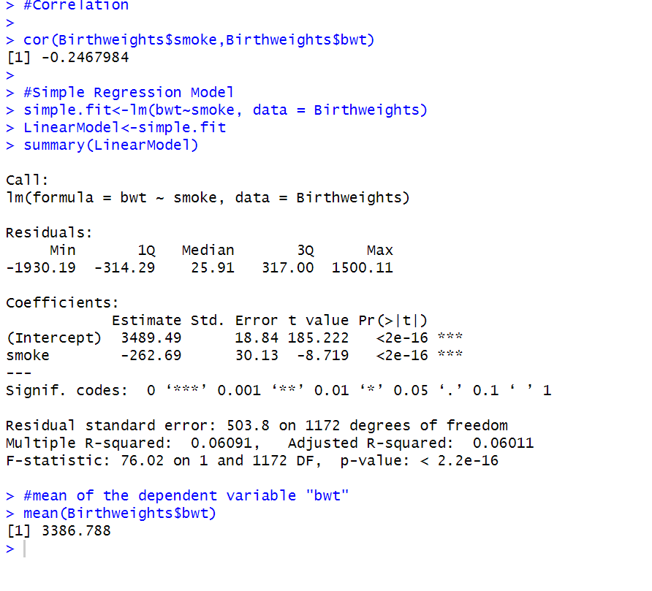
.
9.F-Statistics:Here the F value is 76.02 which indicate that the independent variable ‘smoke’ details more variations in birth weight than other.
10.Mean of the Dependent Variable(bwt):The average of the dependent variable(bwt) is 3386.788g
11.Correlation Coefficient: The negative value of the correlation ( -0.2467984 )suggest that there is a weak relation when the smoking of mother increases birth weight decreases slightly.
12.P-Value and Conclusion:Here the P value is 2.2e-16 which is less than the significance level 0.05.We reject null hypothesis and conclude that the smoking of mother affect the birth weight of the newborn baby.

Slide 16
MULTIPLE LINEAR REGRESSION:
It is a statistical method to analyzes the relationships between one dependent variable and multiple independent predictor variables.
The Equation for the Multiple Linear Regression is
Y=β0​+β1​X1​+β2​X2​+⋯+βk​Xk​+ε
Where:
Y = Dependent variable ,here it is birth weight.
β0 = Intercept
β1,β2,…,βk​ = Coefficients for each independent variable.
X1,X2,…,Xk​ = Independent variables.
ε = Error term

Slide 17
Multiple Linear Regression(Analysis):
I will be using the following steps for Conducting the Multiple Linear
Regression Model.
1)Define the Hypothesis:
Null Hypothesis (H₀):β1​=β2​=⋯=βk​=0 which means none of the independent variables have any significant relationship between dependent variable ‘bwt’
Alternative Hypothesis (​Ha):At least one βi​ ≠ 0 which means at least one of the independent variable has a significant relationship between the dependent variable ‘bwt’
2)Determine the Significance level(α):Here I have to chose the significance level(α=0.05), 95% significance level.
3)Conduct the F statistics and find the statistics values
4)obtain the P-value from the above test and compare it with significance level (α)
5)Arrive a conclusion using the test Statistics and P value.

Slide 18
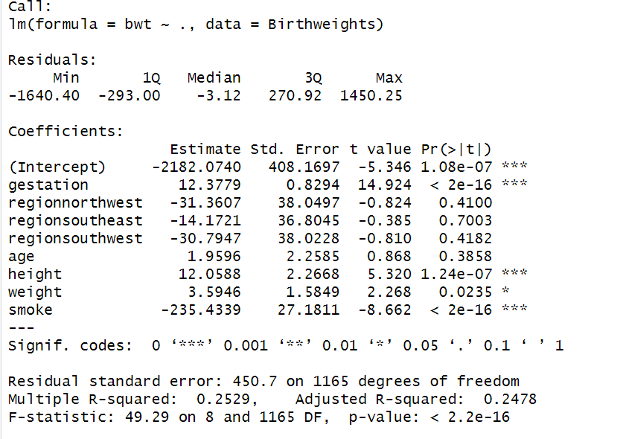
Multiple Linear Regression( Output Analysis):
Based on the R-Output,the Multiple Regression Model can be written as,
Y=β0​+β1​X1​+β2​X2​+⋯+βk​Xk​+ε
bwt=-2182.0740+12.3779(gestation)-31.3607(regionnorthwest)-14.1721(regionsoutheast)-30.7947(regionsouthwest)+1.9596(age)+12.0588(height)+3.5946(weight)-235.4339(smoke)
1.Call: It tells about the dependent variable(bwt) and all the independent variables and shows all these variables in the “Birthweights” data.
2.Residuals:Residuals provide the values of difference between the actual birth weight and predicted birth weight value.

Slide 19
Min: The negative value of -1640.40 indicate that the model is over predicted by the birth weight of 1640.40
Max:The positive value of 1450.25 pointed out that the model is underpredicted by the value of 1450.25
1st Quartile(1Q):The value -293 indicate that 25% of residual coming under -293 grams of newborn baby’s weight.
3rd Quartile(3Q):The value 270.92 indicate that 75% of residual coming under 317 grams of newborn baby’s weight.
Median: It indicate the half of the residuals are coming under -3.12g
3.Intercept:When all predictors are predicted bwt is -2182.0740g
4.Gestation: Every one day of gestation birth weight increases by ~12.3779g and which results it is highly significant.

Slide 20
5.Region: It is clear from the R output that no regional category is statistically significant compared to the reference region because all the P values(0.4100,0.7003,0.4182) is greater than significance level of 0.05 and we will fail to reject the null hypothesis.
6.Age: Since the P value of the Age is greater than 0.05 we fail to reject null hypothesis, and we can say that Age has no significance relationship b/w birth weight(bwt).
7.Height: It is clear that every 1 cm increase in mothers height will cause newborn birth weight increases by 12.06g and the P value is less than 0.05 which indicate that it is significant to birth weight increase.
8.Weight: For every 1kg increase in maternal weight, birth weight increases by 3.5946g and the P value is less than 0.05 which indicate that it is significant to birth weight increase.
9.Smoke:It is clear that mother with smoking habit give the birth to the baby has a weight less than others with a weight of -235.4339 and it is significant.

Slide 21
10.Residual standard error: It is the Average distance between actual and predicted birth weights (~450g)
11.R-squared: The value is 0.2529 which indicate that the Model explains 25.3% of the variance in birth weight of newborn child.
12.Adjusted R-squared:The value is 0.2478 which indicate that Slightly penalizes for including multiple predictors.
13.F-statistic and p-value: The model is statistically significant overall because least one of the independent variables in the model is significantly related to birth weight(bwt) and the P value of these Independent variables is less than the Significance level of 0.05.
In conclusion we reject null hypothesis and conclude that at least one of the Independent variable has a significant relationship between the birth weight of new born baby.

Slide 22
CONCLUSION:
The Analysis involved 1,174 observations to investigate birthweight determinants. The data analysis through simple linear regression confirmed that birthweight typically suffers from maternal smoking practices. The model shows that infants born to mothers who smoke weigh 235 grams less than newborns from nonsmoking mothers thus indicating the adverse health effects of prenatal smoking. A multiple linear regression analysis contained all independent variables including gestation, region, age, height, weight, and smoking status. Analysis results demonstrated gestational period as well as maternal height and weight measurements with smoking status as variables which substantially influence birthweight measurements, but maternal region and age did not demonstrate statistical significance. The total variance of birthweight is described by this model to approximately 25% and it shows significant statistical strength. Birthweight depends significantly on the health condition of expectant mothers together with their behaviors including smoking and physical health parameters. Attempts to help women stop smoking alongside strategies to maintain pregnancy health would significantly enhance the well-being of newborns.

Slide 23
THANK YOU

